Slide 1
Multiobjective SA/TSCC

Slide 2
Issues
Pareto front --> multiple individuals can be be considered „best“
Context vector -> context vectors
How many CVs
Requirements to be considered as CVs
How to build and maintain population
Sensitivity analysis result will be different for each objective
MO-CMA-ES is a bit tricky on the parameters

Slide 3
Alternative 1
Use indicator based solver on top level archive
CV = points used by solver with highest HV contrib, e.g. in SMS-EMOA the points forming the HV is the CV
Population:
Top level: CV (kind of an archive)
Each subproblem maintains its own population
Sensitivity analysis -> create subproblems separately for each objective. Effectively multiplying the population by number of objectives
Cooperation will be always with the top level archive
Local search around the highest HV contributor -> pressure to the Pareto front or increase diversity. Seems suitable for steady-state

Slide 4
Similar work
Luis Miguel Antonio and Carlos A Coello Coello. 2013.
Use of cooperative coevolution for solving large scale multiobjective optimization problems.
Offspring generated in each subproblem, cooperate with random non-dominated parents of other subproblems
B. Luis Miguel Antonio and Carlos A Coello Coello. 2016.
Indicator-Based Cooperative Coevolution for Multi-objective Optimization
Offspring generated in each subproblem, cooperate with highest HV contrib parent of other subproblems
Best solutions are considered from all population of all subproblem (vary in size at each run)
Antonio uses collaboration with best of other subproblem because there is no top level archive

Slide 5
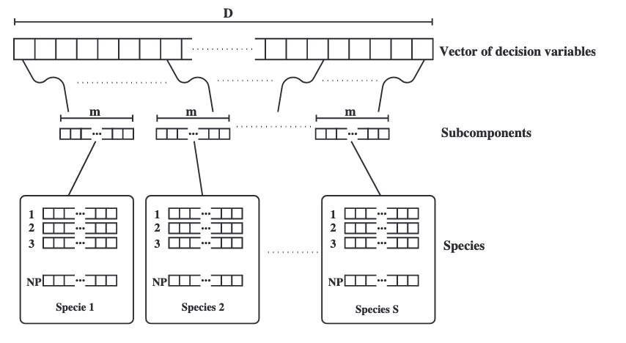
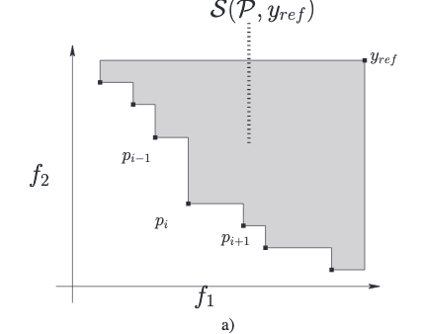
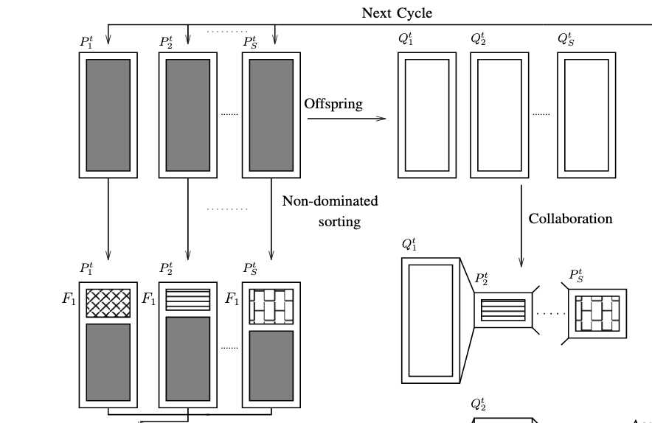
Method A.

Slide 6
Alternative 2
Use indicator based solver on top level
CV = points used by solver which are closest in design space to the offspring.
Population:
Top level: CV (kind of an archive)
Each subproblem maintains its own population
Sensitivity analysis -> create subproblems separately for each objective. Effectively multiplying the population by number of objectives
Cooperation will be always with the top level archive
Local search around the the current top level archive-> pressure to the Pareto front. Non-steady-state.

Slide 7
CV:
(0 0 0 0), (1 1 1 1), (2 2 1 1)
Offspring
(0 1 x x), distances (L2-norm): (1, 1, 5^0.5) -> x x = either 0 0 or 1 1.
(0 0.5 x x), x x = 0 0
Multiple offspring may cooperate with different CV

Slide 8
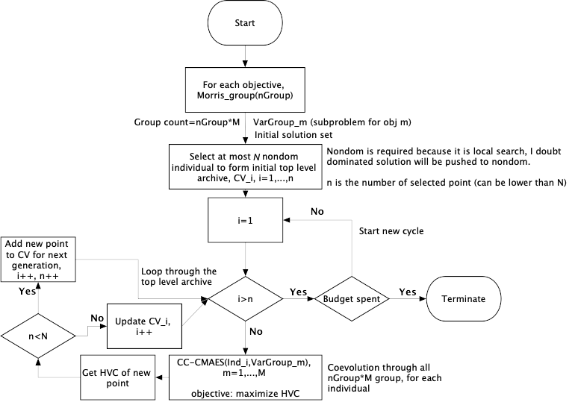
Local HV Improve

Slide 9
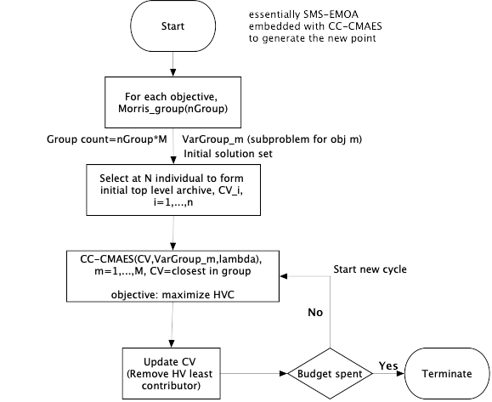
Closest Context Vector

Slide 10
Optimizing HV contribution, round-robin
Previously: Optimizing total HV
Now: Optimizing (penalized) HV contrib.
If nondominated, no penalty
If dominated by other solutions:
Compute the rectangle area bounded by the ref and the new point
Take the (negative) difference between total HV and the area
If dominated by ref point:
Shift reference to new point
Compute total HV, multiply by -1
Step-like function, with 2 jumps depending on domination

Slide 11
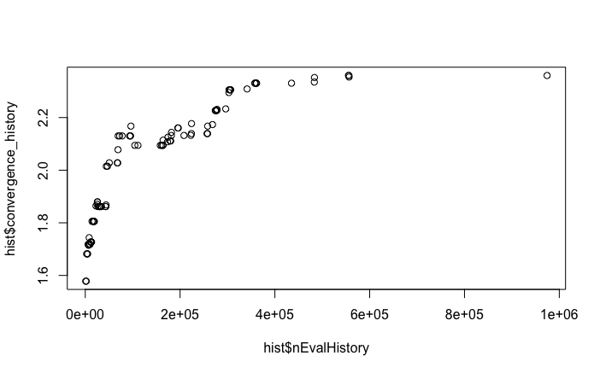
Optimizing HV contribution, round-robin
10 Variables, 2 Objective WFG4. (1 million evaluations, Concave PF)
Population size = 12
Max HV possible (infinite population size): 3.39681469282, reference at (2.2,4.4), PF is ellipsoid with axis radius 2 and 4

Slide 12
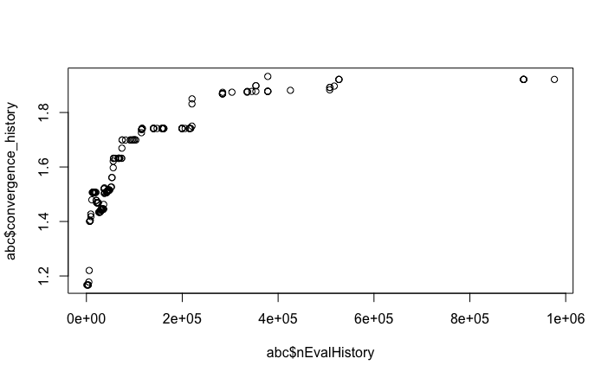
Optimizing HV contribution, round-robin
16 Variables, 2 Objective WFG4. (1 million evaluations, Concave PF)
Population size = 12
Max HV possible (infinite population size): 3.39681469282, reference at (2.2,4.4), PF is ellipsoid with axis radius 2 and 4

Slide 13
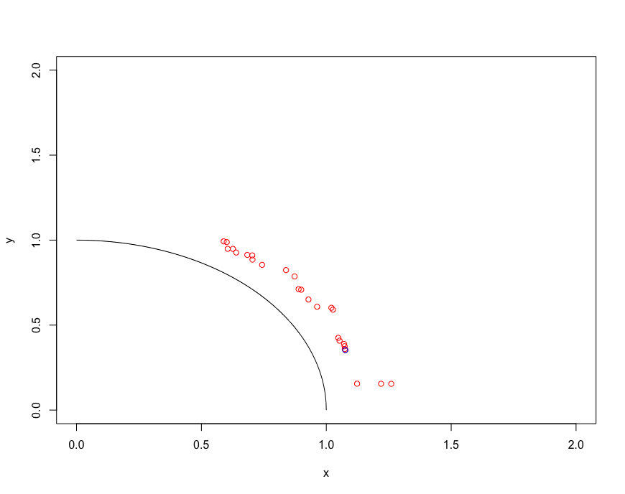
Large scale 100D

Slide 14
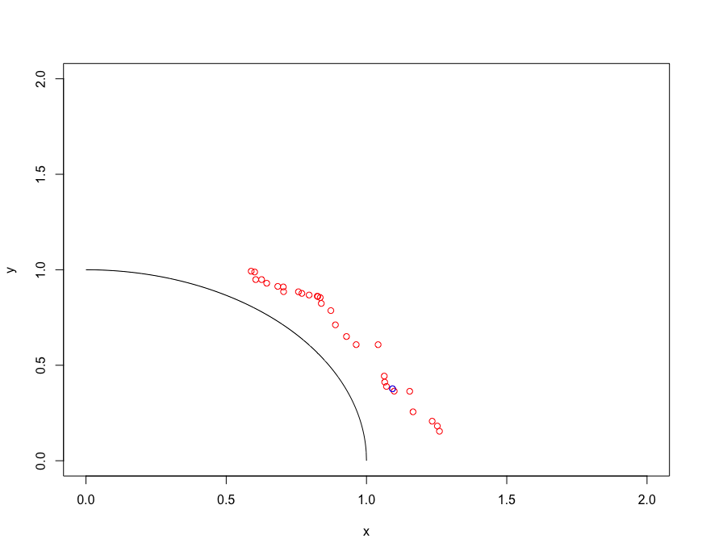
Large scale 1000D

Slide 15
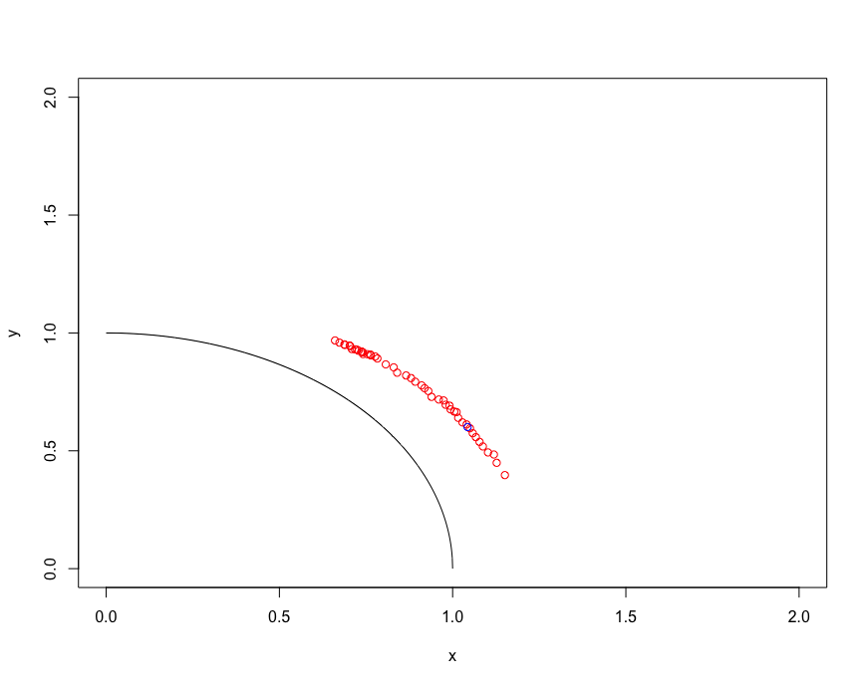
1000D, Shorter max-iter for CMAES

Slide 16
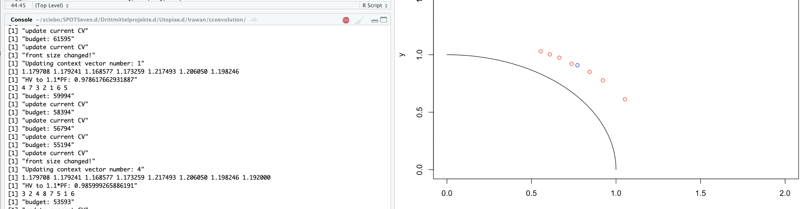
Start with 1

Slide 17
Issues
HV improvement: bigger reward for diversity instead of convergence
CMAES seems to lead to one direction only (despite scaling) – not confirmed in higher dimensions
CMAES does not use information from other (non-dominated) solutions (other than their effect on HV)

Slide 18
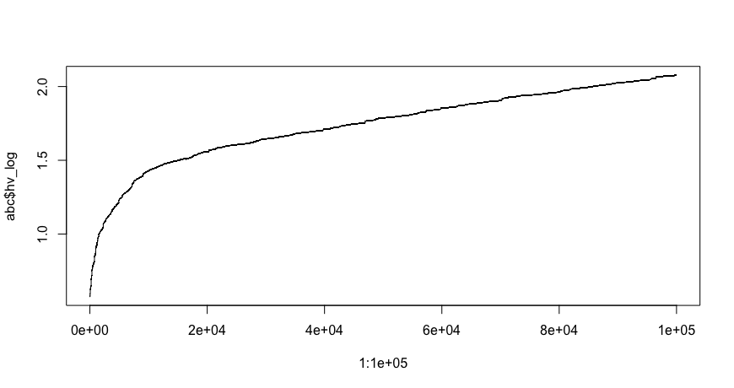
CC-SMSEMOA HV Progression

Slide 19
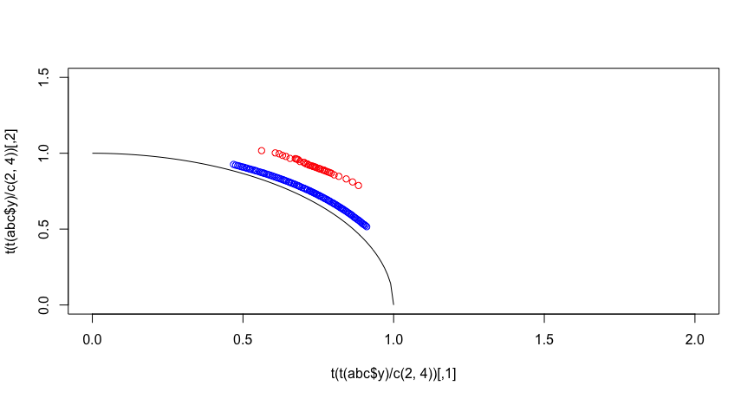
CC-SMSEMOA (blue) vs MOCC-CMAES (red)

Slide 20
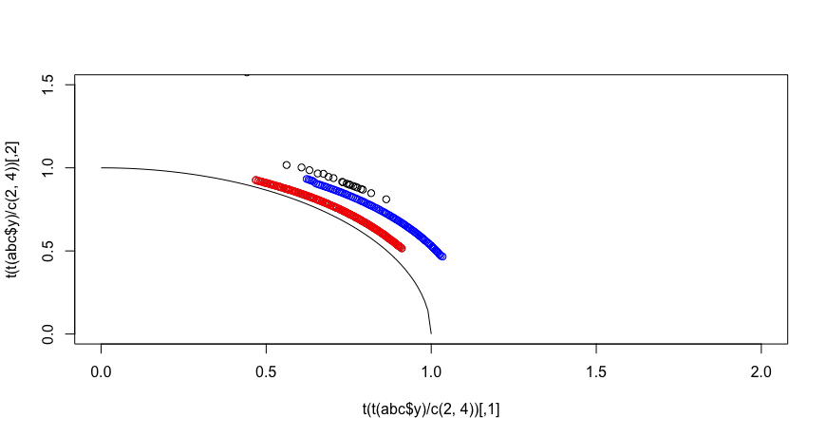
CC-SMSEMOA with closest CV vs far CV

Slide 21
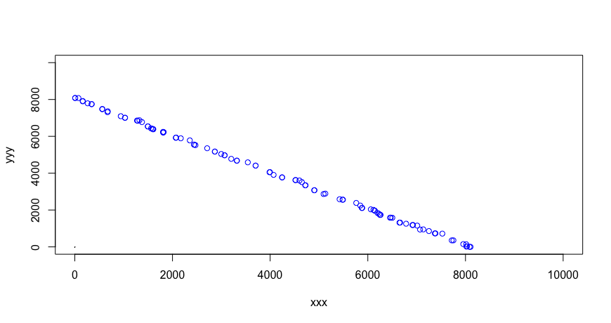
DLTZ1
Good spread, correct shape, bad convergence. PF at x+y=0.5

Slide 22
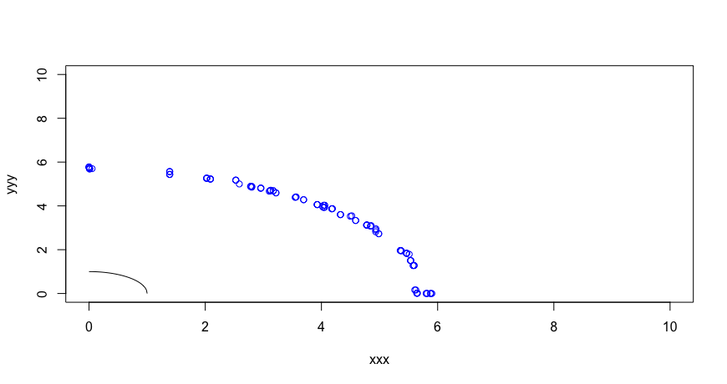
DTLZ2
Good spread, bad convergence. PF at hypersphere radius 1

Slide 23
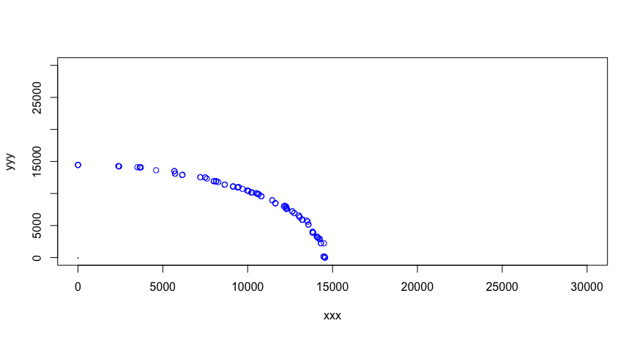
DTLZ3
Good spread, bad convergence. PF at hypersphere radius 1

Slide 24
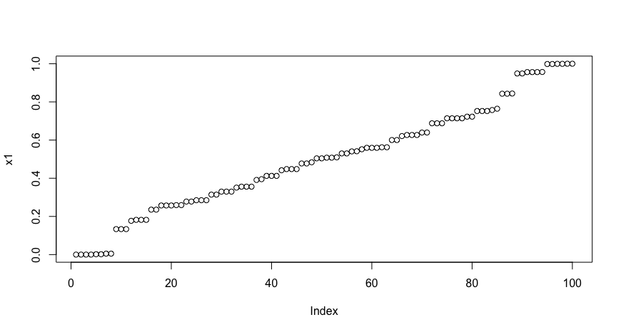
DTLZ reason for good spread
In 2D DTLZ, as long as x1 spread in the interval [0,1], then the shape will be „good“
Location on the front is determined only by x1. x2-x1000 determine the distance
In the figure above for DTLZ3, it can be seen that the 100 points has different x1 values and covers the interval, the shape is guaranteed to be good

Slide 25
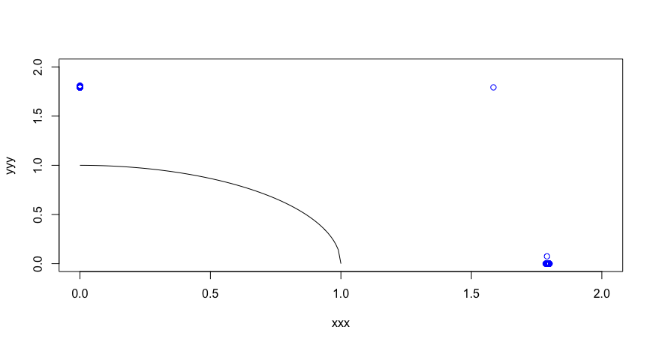
DTLZ4
Very bad performance

Slide 26
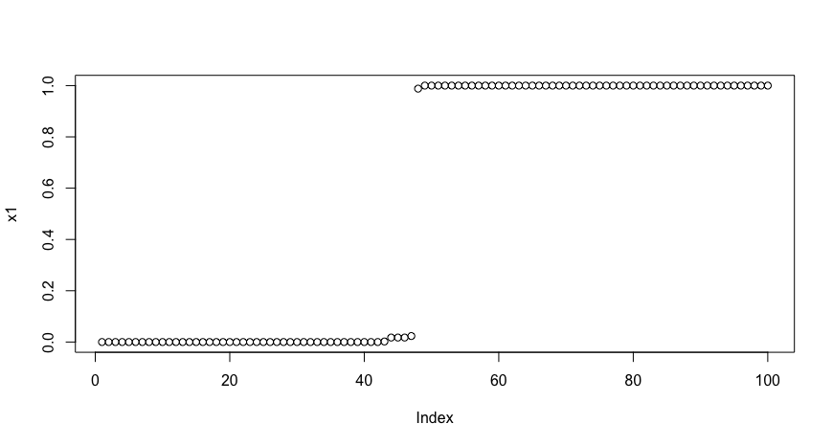
DTLZ4 x1 spread
In 2D DTLZ, as long as x1 spread in the interval [0,1], then the shape will be „good“
Location on the front is determined only by x1. x2-x1000 determine the distance
In the figure above, it can be seen that the 100 points has are at 2 extremes, similar to previous figure

Slide 27
Step size update
Without adaptation, average success rate is at 40%. Rolling success rate 30-40%
Self-adaptive simulated binary crossover for real-parameter optimization (Deb, et al. 2007)
Increase step size if offspring is successful + vice versa
Update is on each iteration
One additional parameter: adaptation rate (used the default value)
Rolling success rate is 30-50%

Slide 28
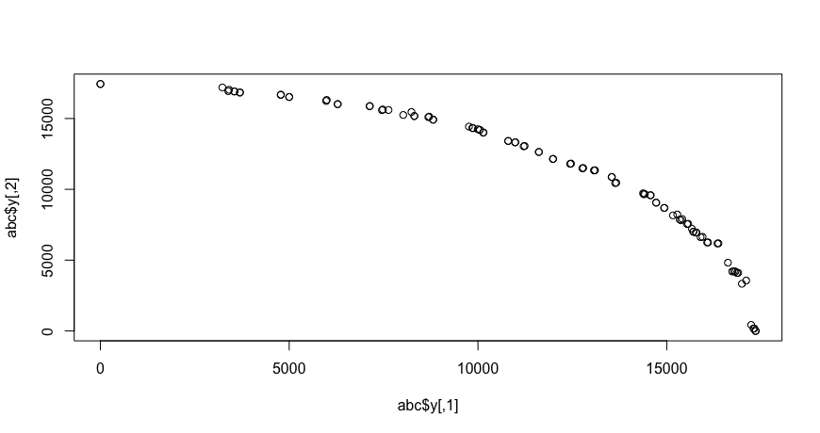
Step size update
Slightly worse

Slide 29
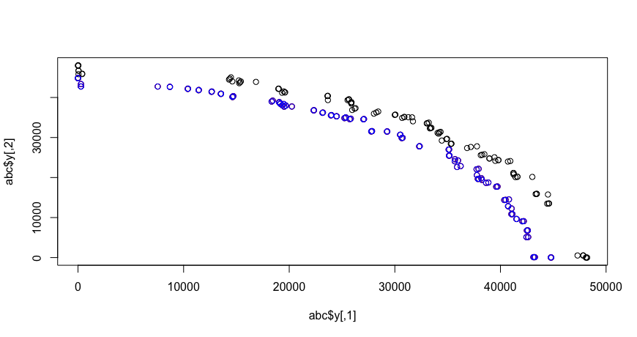
Change to context vector rule
Improved performance by changing CV from closest to 1 parent

Slide 30
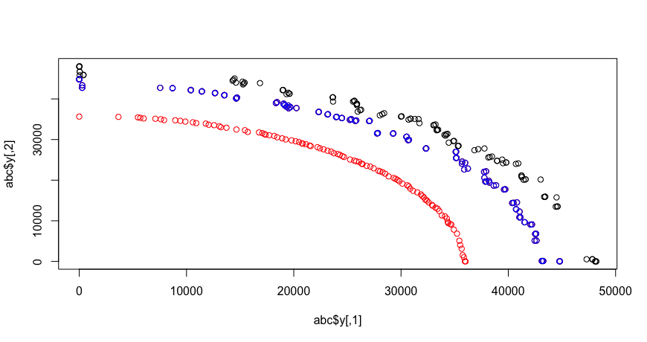
Increased mutation rate
Improved performance by increasing mutation rate to 1. All variables in the group will be mutated.
Success rate drops to ~15-25%

Slide 31
The story
Standard SMS-EMOA is slow because of the crossover and muttion is working on large dimension.
We cannot get close to the Pareto front using standard MOEAs in large scale setting
Difficulty in using CC due to the grouping takes many function evluation, even more so in many-objective settings
Sensitivity analysis grouping can solve the grouping issue
Still not close enough to pareto front

Slide 32
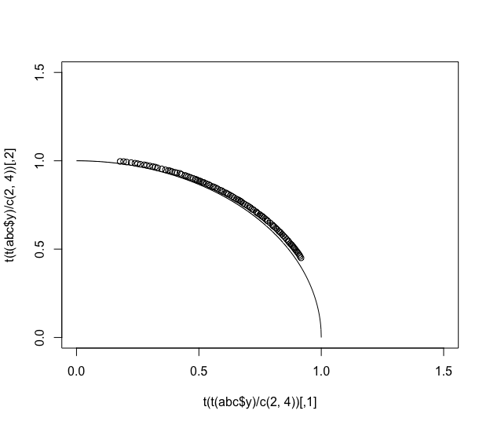
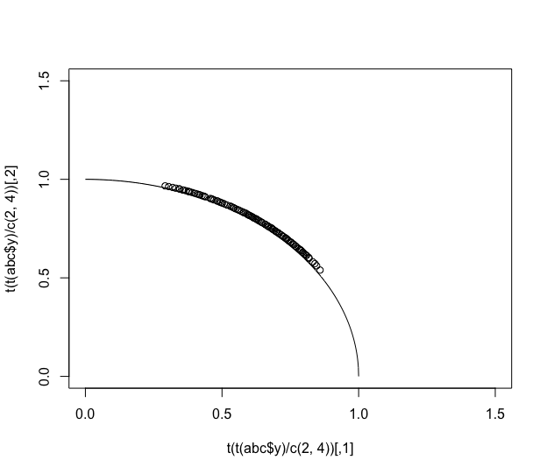

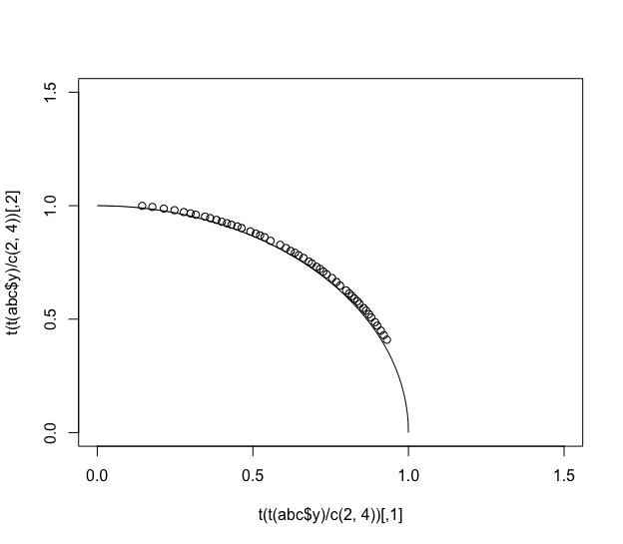
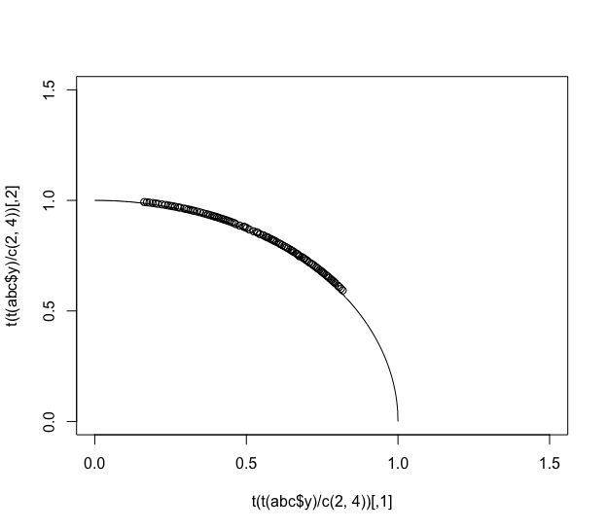
Further Insight (100D, 25 spread var)
Adaptive
(more groups)
(Startsmall)
Focus on subset of
„distance variable“
(need to know which)
Focus on „spread variable“
(need to know which)

Slide 33
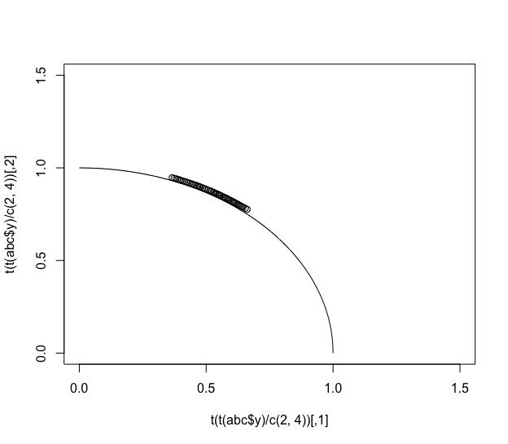
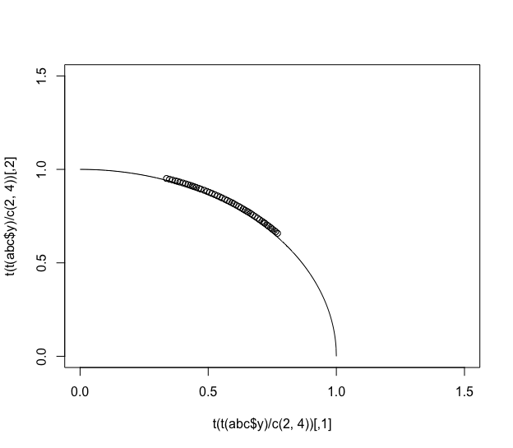
Applied to 1000D
Adaptive
(Startsmall 10 groups)
(Startsmall 50 groups)

